Slide 1
SATELLITE LIFE EXPECTANCY
Joshlyn Jamerson
Notes:
Good afternoon, my name is Joshlyn Jamerson and this presentation is about satellite life expectancy.

Slide 2
AGENDA
Stakeholder Interest
Database Information
Hypotheses
Regression
Notes:
Here’s an overview of the topics I’m going to cover.
I’ll start with giving information about the database, discuss my hypothesis, go over my regression model, and the results of my research.

Slide 3
STAKEHOLDER INTEREST
Resource Allocation
Operational Continuity
Cost Management
Situational Awareness in the Space Domain
Notes:
So why does knowing about satellite life expectancy benefit military stakeholders?
Knowing about what affects the life of a satellite allows for better mission planning, including scheduling replacements or adjustments to ensure continuous and reliable satellite coverage.
Satellites play a crucial role in maintaining situational awareness, command and control, and communication during various operations. Knowing which attributes provide longer lifetimes can contribute to more reliable and sustained operations.
Satellite development, launch, and maintenance are extremely costly. By understanding factors that influence satellite longevity, the military can make informed decisions about investment in satellite technology, design, and orbits to optimize the cost-effectiveness of their satellite programs.
Space situational awareness, which involves monitoring and tracking objects in space, helps to prevent collisions and protect satellites from potential threats. Knowledge of satellite lifetimes can aid in predicting end-of-life scenarios and potential debris creation.

Slide 4
COLUMNS OF INTEREST
Expected Lifetime (Years)
Launch Mass (Kilograms)
Inclination (Degrees)
Apogee (Kilometers)
Perigee (Kilometers)
Class of Orbit
Notes:
The columns I was interested in include:
Expected Lifetime, Launch Mass, Inclination, Perigee, Apogee, and Class of Orbit

Slide 5
DATA WRANGLING
Inconsistencies with Expected Lifetime (Years)
Transformed Categorical Columns
Deleted null values
Expected Lifetime (Years)
Launch Mass (Kilograms)
Notes:
This is how I had to clean up the data to make it usable.
The majority of the issues were in the expected lifetime column. Some of the data was in ranges while others were just a specific number. To tackle this issue, I replaced the range with the mean.
I also had to transform the categorical columns to numerical values which allowed me to make comparisons between how the different orbits behaved.
There were null values in both the expected lifetime column and in the launch mass column, so I deleted the null rows to avoid any complications with the data.

Slide 6
HYPOTHESIS
Satellites in GEO will have a longer life expectancy compared to those in other orbits
Notes:
My hypothesis is that satellites in GEO will have a longer life expectancy compared to those in other orbits.

Slide 7
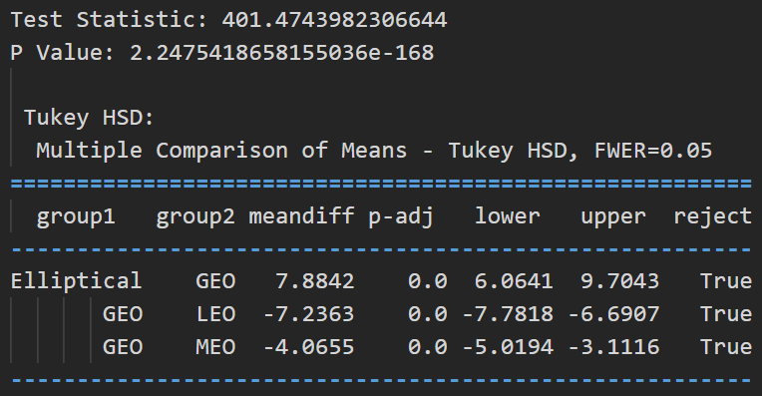
HYPOTHESIS TESTING
ANOVA TEST
Significance level = 0.05
Hypothesis is Correct
Low P value
High Test Statistic
Notes:
An ANOVA test shows if there are statistically significant differences in means among three or more groups.
I decided to use an ANOVA test for my hypothesis as it allowed me to determine whether the means of the life expectancy for each orbit were significantly different from each other.
This test compares the variability within each orbit to the variability between the orbits and calculates a test statistic and p-value to assess the significance of the differences.
In this test, I set my significance level to 0.05 which means that if the p-value is greater than 0.05 then we do not have enough evidence to prove my hypothesis to be correct.
In this case, our P value is significantly smaller than 0.05 which means that this my hypothesis is correct, proving that satellites in GEO have a longer life expectancy than those in other orbits.
I also used a Tukey HSD after completing the ANOVA test which shows the specific comparison between each group. It shows the mean difference in years. It also shows that in each scenario we can reject the null hypothesis.

Slide 8
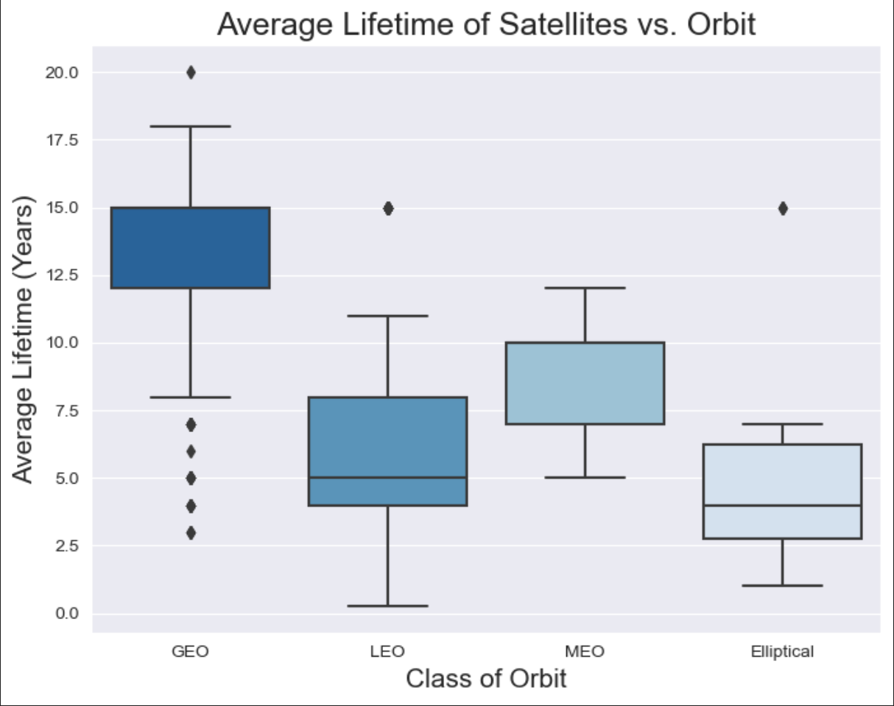
Notes:
Here is a visual representation that shows the average life-time of a satellite based on years.
As you can see GEO has the highest life expectancy whereas elliptical has the lowest life expectancy.

Slide 9



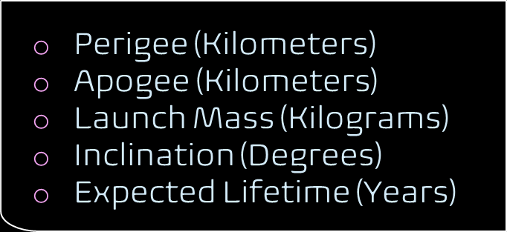


Linear regression model
Notes:
In addition to the hypotheses, I wanted to see if these features had an effect on a satellite’s expected lifetime.
Perigee is location when the satellite is closest to the Earth.
Apogee is the location when the satellite is farthest from the Earth.
Inclination refers to the title of the satellite.
I chose to use perigee and apogee instead of the orbits as these are numerical values instead of categorical. This provided my model with higher accuracy.
The model, based on the Ordinary Least Squares (OLS) method which is a linear regression technique used to estimate the parameters of a linear model by minimizing the sum of squared differences between the observed and predicted values..
The results of this demonstrates a reasonable fit to the data with an R-squared value of 0.604. This means that about 60.4% of the variance in the expected lifetime of satellites is explained the chose features

Slide 10
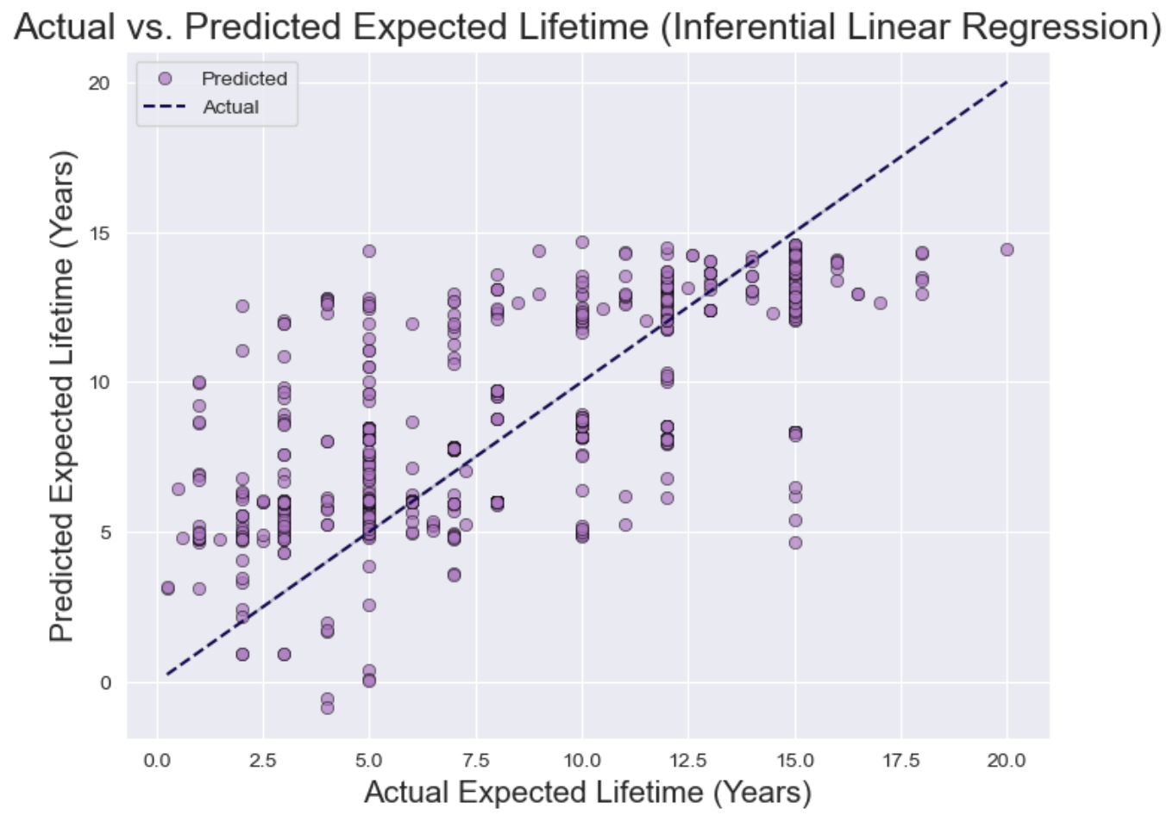
Notes:
This graph is showing the comparison between the actual expected lifetimes of satellites and the predicted expected lifetimes generated by the inferential linear regression.
Each point on the graph represents an individual satellite observation.
The x-axis represents the actual expected lifetime of the satellites (in years), while the y-axis represents the predicted expected lifetime (also in years) generated by the regression model.
The purple dots scattered across the graph represent the predicted values.
The dashed blue line represents the ideal scenario where the predicted values perfectly match the actual values.
This shows how well the model's predictions align with the actual data.

Slide 11
CONTACT INFO
Joshlyn Jamerson
Joshlyn.Jamerson@spaceforce.mil
Original dataset: https://www.kaggle.com/datasets/ucsusa/active-satellites
GitHub Repository: https://github.com/joshlynj/active_satellites
Notes:
Here’s my contact information.
Thank you all for your time.
Are there any questions?

Slide 12
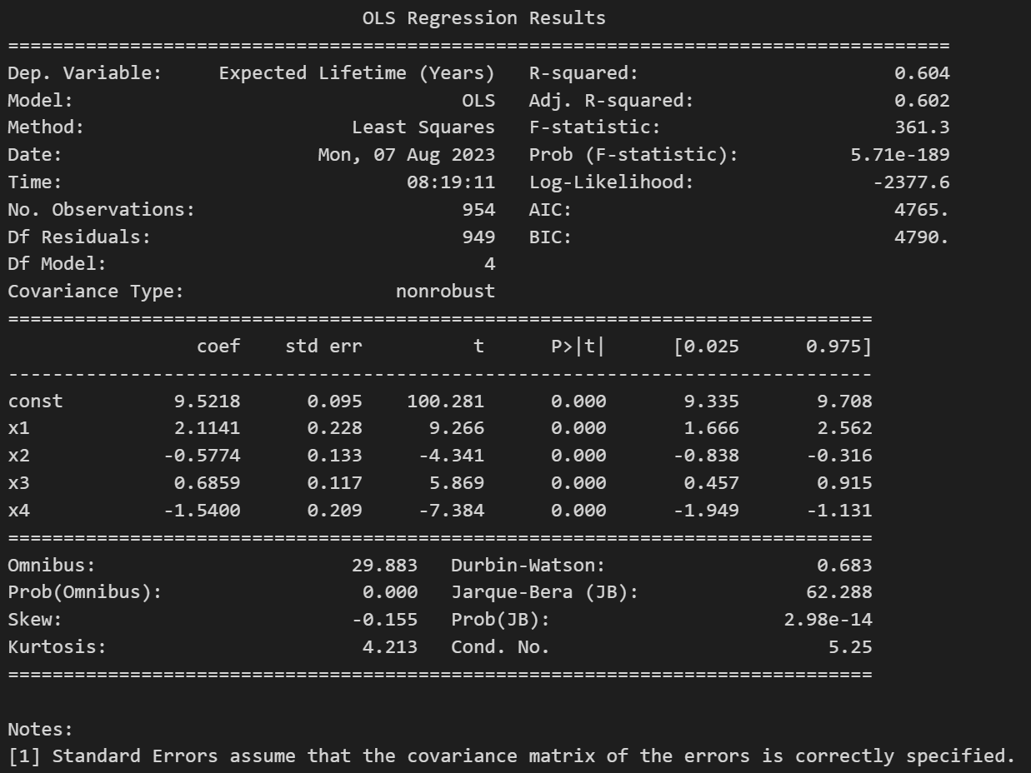
Notes:
The regression analysis conducted on the dataset provides valuable insights into the relationship and their expected lifetimes.
between satellite characteristics
The model, based on the Ordinary Least Squares (OLS) method, demonstrates a reasonable fit to the data with an R-squared value of 0.604, indicating that approximately 60.4% of the variance in the expected lifetime of satellites is explained by the chosen predictor variables.
The F-statistic of 361.3 and associated low probability value (p-value) affirm the overall significance of the regression, implying that the model as a whole is meaningful.

Slide 13
Linear regression model
Features of Interest
Model
Results
Perigee (Kilometers)
Apogee (Kilometers)
Launch Mass (Kilograms)
Inclination (Degrees)
Expected Lifetime (Years)
Ordinary Least Squares
R-Squared Value: 0.604
Notes:
In addition to the hypotheses, I wanted to see if these features had an effect on a satellite’s expected lifetime.
I chose to use perigee and apogee instead of the orbits as these are numerical values instead of categorical. This provided my model with higher accuracy.
The model, based on the Ordinary Least Squares (OLS) method, demonstrates a reasonable fit to the data with an R-squared value of 0.604, indicating that approximately 60.4% of the variance in the expected lifetime of satellites is explained the chose features

